Slide 1
False Discovery Rate Methods for
Functional Neuroimaging
Thomas Nichols
Department of Biostatistics
University of Michigan

Slide 2
Outline
Functional MRI
A Multiple Comparison Solution:
False Discovery Rate (FDR)
FDR Properties
FDR Example

Slide 3
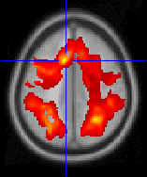
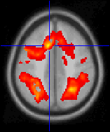
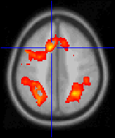
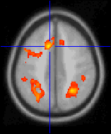
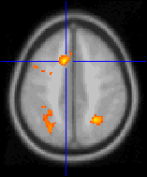
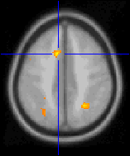
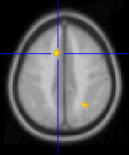
fMRI Models &
Multiple Comparisons
Massively Univariate Modeling
  Fit model at each volume element or “voxel”
  Create statistic images of effect
Which of 100,000 voxels are significant?
  α=0.05 ⇒ 5,000 false positives!
t > 0.5
t > 1.5
t > 2.5
t > 3.5
t > 4.5
t > 5.5
t > 6.5

Slide 4
Solutions for the
Multiple Comparison Problem
A MCP Solution Must Control False Positives
  How to measure multiple false positives?
Familywise Error Rate (FWER)
  Chance of any false positives
  Controlled by Bonferroni & Random Field Methods
False Discovery Rate (FDR)
  Proportion of false positives among rejected tests

Slide 5
False Discovery Rate
 | Accept | Reject
Null True | V_{0A} | V_{0R} | m₀
Null False | V_{1A} | V_{1R} | m₁
 | N_{A} | N_{R} | V
Observed FDR
obsFDR = V_{0R}/(V_{1R}+V_{0R}) = V_{0R}/N_{R}
  If N_{R} = 0, obsFDR = 0
Only know N_{R}, not how many are true or false
  Control is on the expected FDR
  FDR = E(obsFDR)

Slide 6






















False Discovery Rate
Illustration:
Noise
Signal
Signal+Noise

Slide 7






























Control of Per Comparison Rate at 10%
11.3%
11.3%
12.5%
10.8%
11.5%
10.0%
10.7%
11.2%
10.2%
9.5%
Percentage of Null Pixels that are False Positives
Control of Familywise Error Rate at 10%
FWE
Occurrence of Familywise Error
Control of False Discovery Rate at 10%
6.7%
10.4%
14.9%
9.3%
16.2%
13.8%
14.0%
10.5%
12.2%
8.7%
Percentage of Activated Pixels that are False Positives

Slide 8
Benjamini & Hochberg
Procedure
Select desired limit q on FDR
Order p-values, p₍₁₎ ≤ p₍₂₎ ≤ ... ≤ p_{(V)}
Let r be largest i such that
Reject all hypotheses
corresponding to
p₍₁₎, ... , p_{(r)}.
JRSS-B (1995)
57:289-300
1
p_{(i)} ≤ i/V × q/c(V)
p_{(i)}
p-value
i/V × q/c(V)
0
0
i/V
1

Slide 9
Benjamini & Hochberg Procedure
c(V) = 1
  Positive Regression Dependency on Subsets
    P(X₁≥c₁, X₂≥c₂, ..., X_{k}≥c_{k} | X_{i}=x_{i}) is non-decreasing in x_{i}
    Only required of test statistics for which null true
    Special cases include
      Independence
      Multivariate Normal with all positive correlations
      Same, but studentized with common std. err.
c(V) = Σ_{i=1,...,V} 1/i ≈ log(V)+0.5772
  Arbitrary covariance structure
Benjamini &
Yekutieli (2001).
Ann. Stat.
29:1165-1188

Slide 10
Other FDR Methods
John Storey JRSS-B (2002) 64:479-498
  pFDR “Positive FDR”
    FDR conditional on one or more rejections
    Critical threshold is fixed, not estimated
    pFDR and Emperical Bayes
  Asymptotically valid under “clumpy” dependence
James Troendle JSPI (2000) 84:139-158
  Normal theory FDR
    More powerful than BH FDR
    Requires numerical integration to obtain thresholds
  Exactly valid if whole correlation matrix known

Slide 11
Benjamini & Hochberg:
Key Properties
FDR is controlled
E(obsFDR) ≤ q m₀/V
  Conservative, if large fraction of nulls false
Adaptive
  Threshold depends on amount of signal
    More signal, More small p-values,
    More p_{(i)} less than i/V × q/c(V)

Slide 12
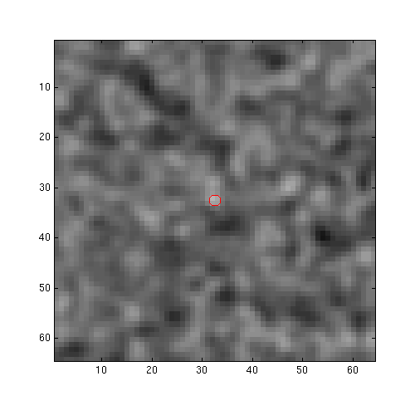
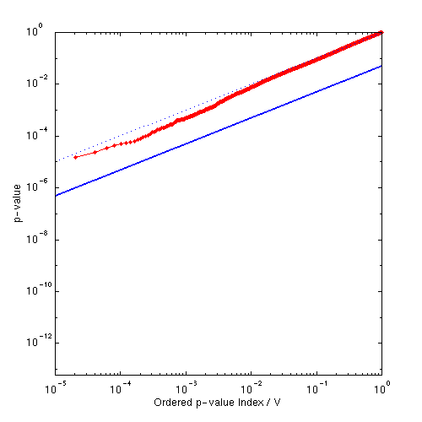
Controlling FDR:
Varying Signal Extent
p = z =
Signal Intensity 3.0
Signal Extent 1.0
Noise Smoothness 3.0
1

Slide 13
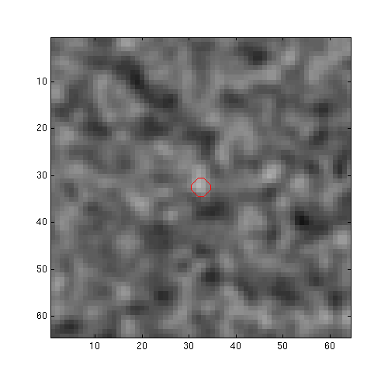

Controlling FDR:
Varying Signal Extent
p = z =
Signal Intensity 3.0
Signal Extent 2.0
Noise Smoothness 3.0
2

Slide 14
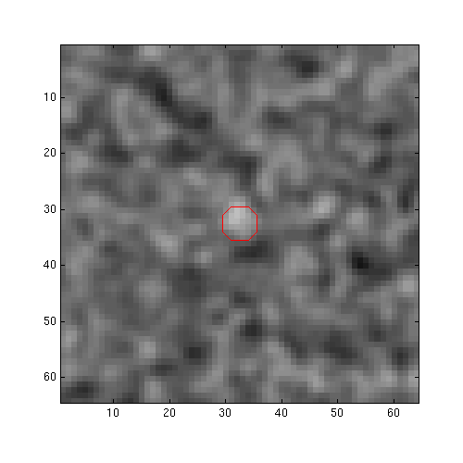

Controlling FDR:
Varying Signal Extent
p = z =
Signal Intensity 3.0
Signal Extent 3.0
Noise Smoothness 3.0
3

Slide 15
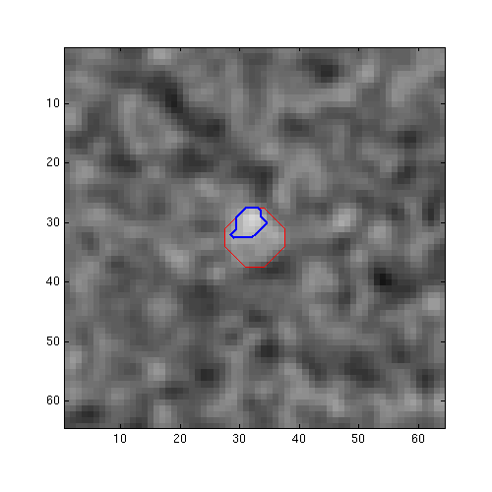
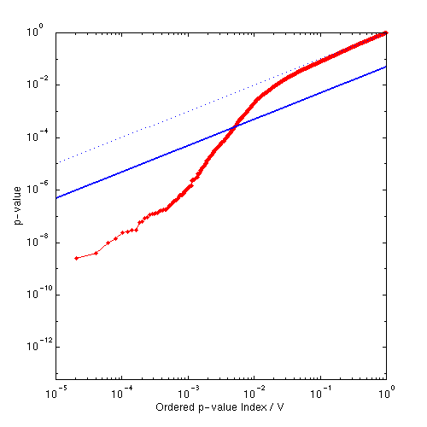
Controlling FDR:
Varying Signal Extent
p = 0.000252 z = 3.48
Signal Intensity 3.0
Signal Extent 5.0
Noise Smoothness 3.0
4

Slide 16
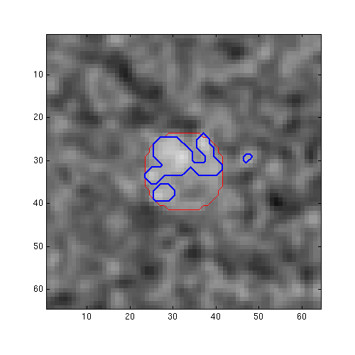
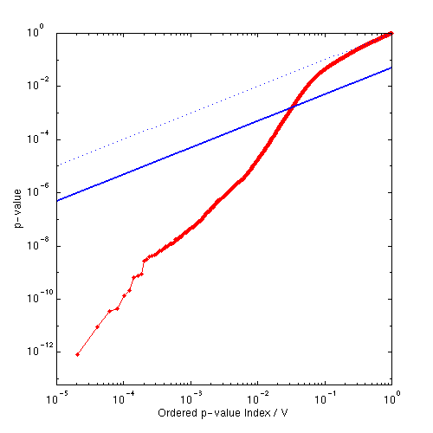
Controlling FDR:
Varying Signal Extent
p = 0.001628 z = 2.94
Signal Intensity 3.0
Signal Extent 9.5
Noise Smoothness 3.0
5

Slide 17
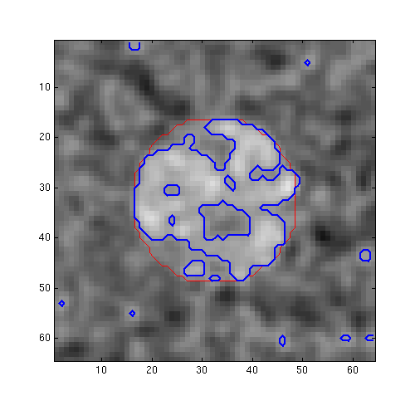
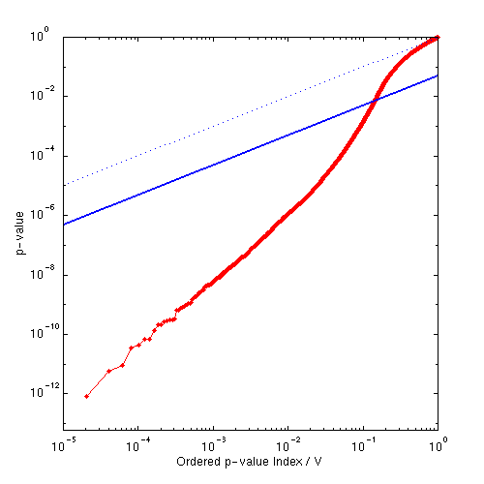
Controlling FDR:
Varying Signal Extent
p = 0.007157 z = 2.45
Signal Intensity 3.0
Signal Extent 16.5
Noise Smoothness 3.0
6

Slide 18
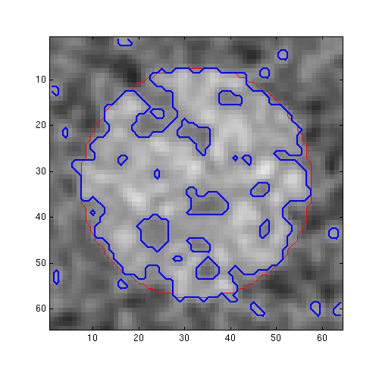
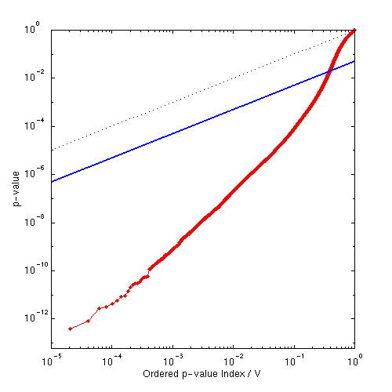
Controlling FDR:
Varying Signal Extent
p = 0.019274 z = 2.07
Signal Intensity 3.0
Signal Extent 25.0
Noise Smoothness 3.0
7

Slide 19
Controlling FDR:
Benjamini & Hochberg
Illustrating BH under dependence
  Extreme example of positive dependence
8 voxel image
1
p_{(i)}
p-value
32 voxel image
(interpolated from 8 voxel image)
i/V × q/c(V)
0
0
i/V
1

Slide 20
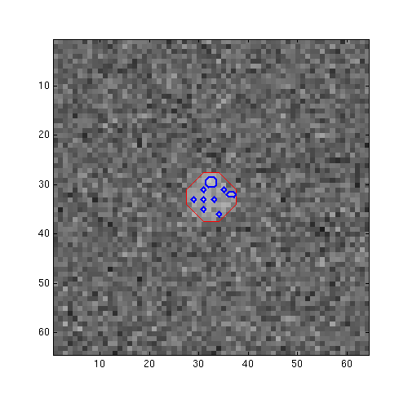
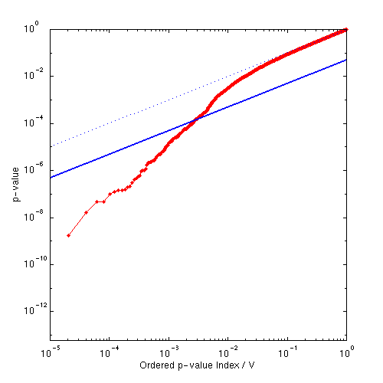
Controlling FDR:
Varying Noise Smoothness
p = 0.000132 z = 3.65
Signal Intensity 3.0
Signal Extent 5.0
Noise Smoothness 0.0
1

Slide 21
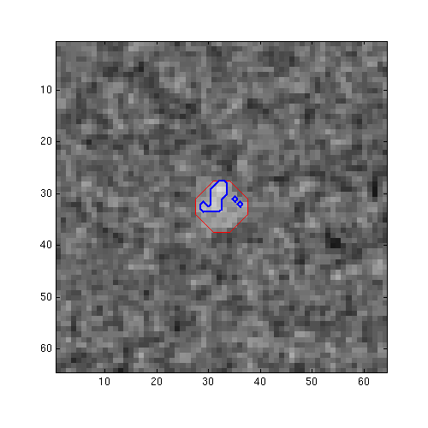
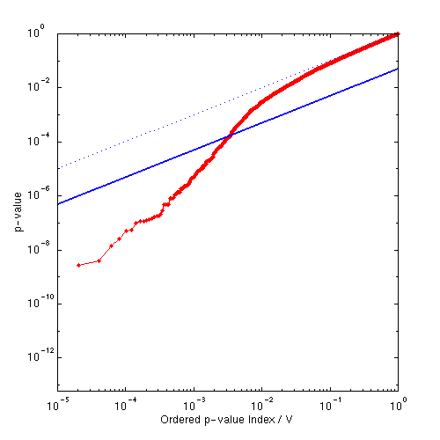
Controlling FDR:
Varying Noise Smoothness
p = 0.000169 z = 3.58
Signal Intensity 3.0
Signal Extent 5.0
Noise Smoothness 1.5
2

Slide 22
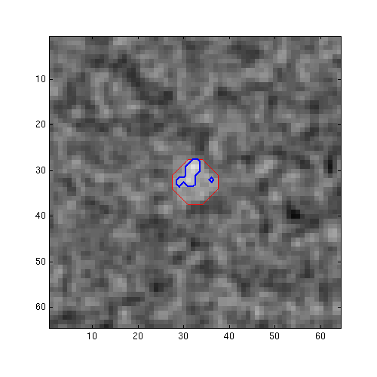

Controlling FDR:
Varying Noise Smoothness
p = 0.000167 z = 3.59
Signal Intensity 3.0
Signal Extent 5.0
Noise Smoothness 2.0
3

Slide 23
Controlling FDR:
Varying Noise Smoothness
p = 0.000252 z = 3.48
Signal Intensity 3.0
Signal Extent 5.0
Noise Smoothness 3.0
4

Slide 24
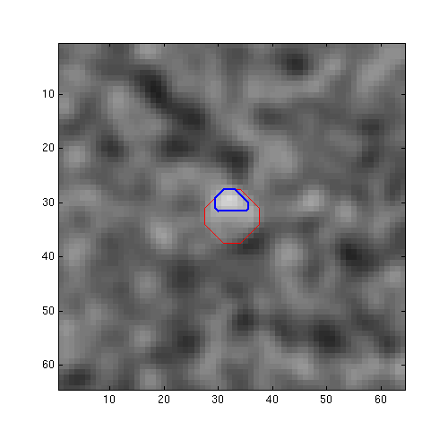
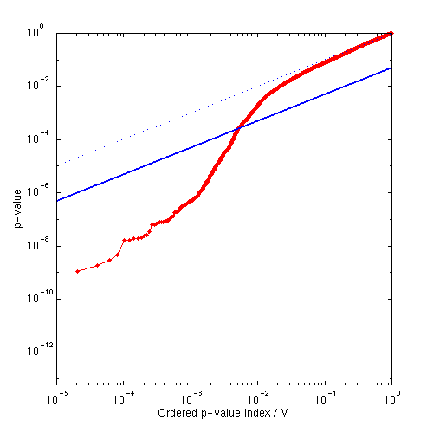
Controlling FDR:
Varying Noise Smoothness
p = 0.000253 z = 3.48
Signal Intensity 3.0
Signal Extent 5.0
Noise Smoothness 4.0
5

Slide 25
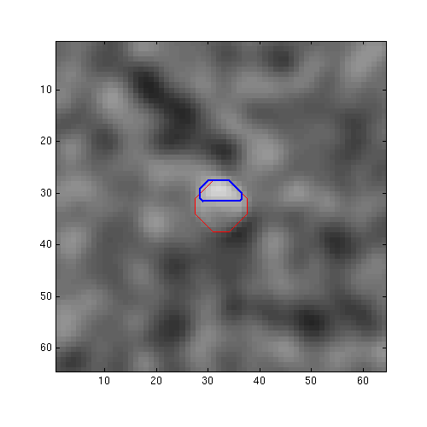
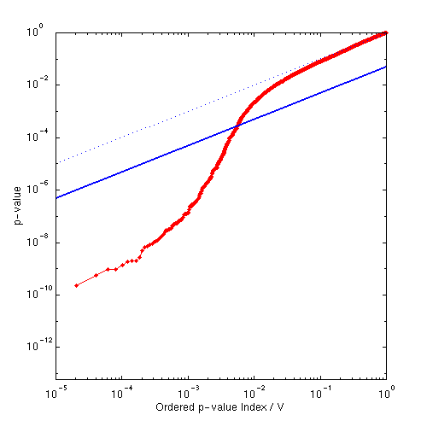
Controlling FDR:
Varying Noise Smoothness
p = 0.000271 z = 3.46
Signal Intensity 3.0
Signal Extent 5.0
Noise Smoothness 5.5
6

Slide 26

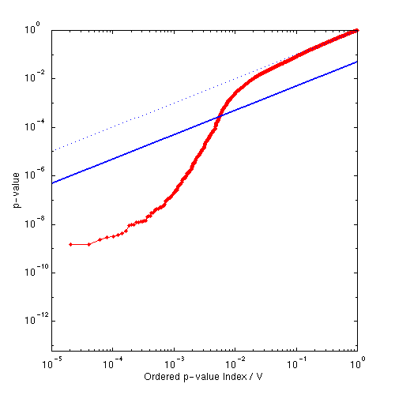
Controlling FDR:
Varying Noise Smoothness
p = 0.000274 z = 3.46
Signal Intensity 3.0
Signal Extent 5.0
Noise Smoothness 7.5
7

Slide 27
Benjamini & Hochberg: Properties
Adaptive
  Larger the signal, the lower the threshold
  Larger the signal, the more false positives
    False positives constant as fraction of rejected tests
    Not such a problem with imaging’s sparse signals
Smoothness OK
  Smoothing introduces positive correlations

Slide 28
Controlling FDR
Under Dependence
FDR under low df, smooth t images
  Validity
    PRDS only shown for studentization by common std. err.
  Sensitivity
    If valid, is control tight?
Null hypothesis simulation of t images
  3000, 32×32×32 voxel images simulated
  df: 8, 18, 28 (Two groups of 5, 10 & 15)
  Smoothness: 0, 1.5, 3, 6, 12 FWHM (Gaussian, 0~5 σ)
  Painful t simulations

Slide 29
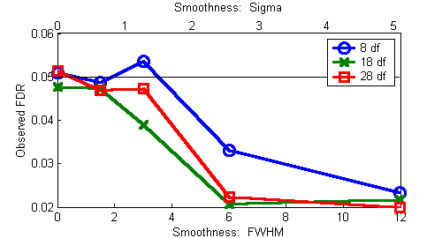
Dependence Simulation
Results
Observed FDR
For very smooth cases, rejects too infrequently
  Suggests conservativeness in ultrasmooth data
  OK for typical smoothnesses

Slide 30
Dependence Simulation
FDR controlled under complete null, under various dependency
Under strong dependency, probably too conservative

Slide 31
Positive Regression Dependency
Does fMRI data exhibit total positive correlation?
Initial Exploration
  160 scan experiment
  Simple finger tapping paradigm
  No smoothing
  Linear model fit, residuals computed
Voxels selected at random
  Only one negative correlation...

Slide 32
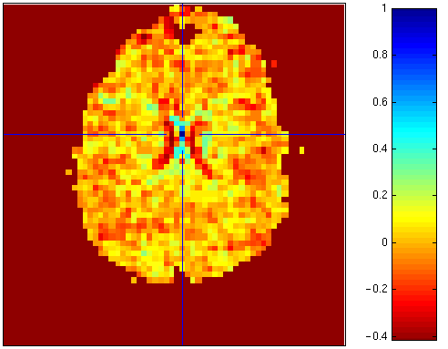
Positive Regression Dependency
Negative correlation between ventricle and brain

Slide 33
Positive Regression Dependency
More data needed
Positive dependency assumption
probably OK
  Users usually smooth data with nonnegative kernel
  Subtle negative dependencies swamped

Slide 34
Example Data
Active
...
fMRI Study of Working Memory
  12 subjects, block design Marshuetz et al (2000)
  Item Recognition
    Active:View five letters, 2s pause,
    view probe letter, respond
    Baseline: View XXXXX, 2s pause,
    view Y or N, respond
Random/Mixed Effects Modeling
  Model each subject, create contrast of
  interest
  One sample t test on contrast images yields pop. inf.
...
D
UBKDA
yes
Baseline
...
...
N
XXXXX
no

Slide 35
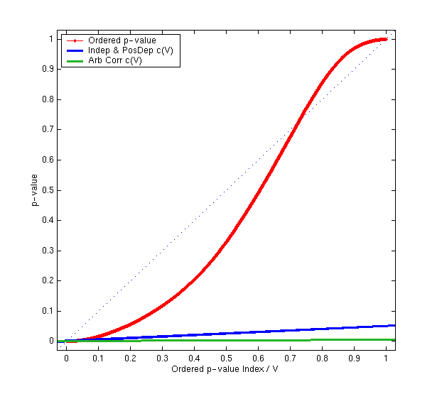
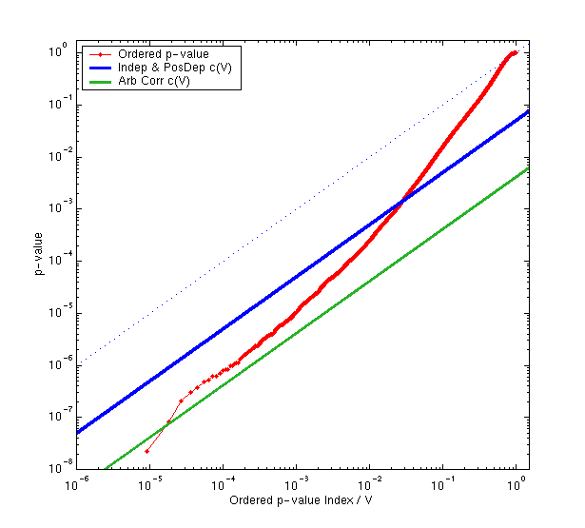
FDR Example:
Plot of FDR Inequality
p_{(i)} ≤ ( i/V ) ( q/c(V) )

Slide 36
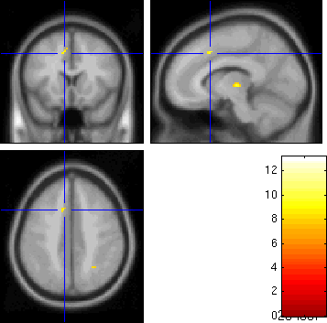
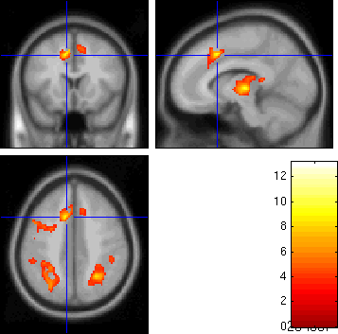
FDR Example
Threshold
  Indep/PosDep
  u = 3.83
  Arb Cov
  u = 13.15
Result
  3,073 voxels above
  Indep/PosDep u
  <0.0001 minimum
  FDR-corrected
  p-value
FWER Perm. Thresh. = 7.67
58 voxels
FDR Threshold = 3.83
3,073 voxels

Slide 37
FDR: Conclusions
False Discovery Rate
  A new false positive metric
Benjamini & Hochberg FDR Method
  Straightforward solution to fMRI MCP
    Valid under dependency
  Just one way of controlling FDR
    New methods under development
Limitations
  Arbitrary dependence result less sensitive
Start
Ill
http://www.sph.umich.edu/~nichols/FDR
Prop

Slide 38
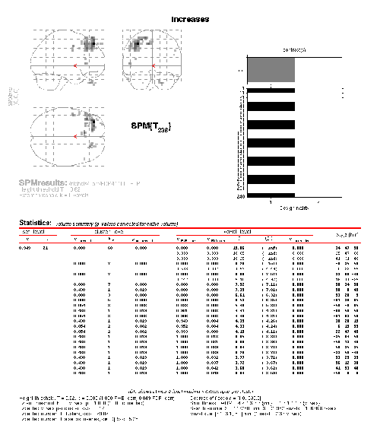
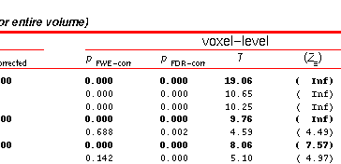
FDR Software for SPM
http://www.sph.umich.edu/~nichols/FDR

